Slide 1
Role of theory in developing communication interventions
Week 7

Slide 2
Pulse-Check
Key Takeaways?

Slide 3
Involving youth in theory
The role of theory in YPAR
Common Themes
Being in conversation with and advancing theory
Limitations of theory
Research validity and rigor concerns
Notes:
Role of theory in YPACR - balance of using theory to inform our interactions with youth as well as the projects we develop with them
Involving and Introducing theory to youth - accessibility
Limitations of theory - lack of consensus on strong, effective messaging, articles from 2006

Slide 4
Spectrum of youth engagement
No Youth
Little
Low
Medium
High
Highest
Adults collect research without collecting any information directly from youth
Information is collected from youth by adult researchers to inform an adult-led process
Youth give input and participate in limited roles in an adult-led process
Youth design research tools, administer them, and help present the findings.
Youth roles include research design, data collection, data analysis, reporting findings and recommendations and implementing change
Youth leadership in community planning, evaluation, design and campaigns is a normal, YPAR is institutionalized in the culture. Experienced youth leaders act as peer trainers and organizers. Young people are paid staff
Notes:
Continuous reflection, check-in about how we’re feeling and where we are in the process
Where We Are Now: Where are we now in terms of youth engagement? Give some evidence.
Where We Aspire to Be: How do we grow and strengthen youth engagement in our organization or community over the next year? Include some specifics.
Habits and Challenges: What is a pattern or ongoing challenge that might make this difficult? How could we lovingly interrupt it?
What We Will Practice in this Cycle of YPAR: How do we want to use this project to develop and cultivate youth engagement in our organization or community? What can we consciously do to support that?

Slide 5
Spectrum of Youth Engagement
Where We Are Now: Where are we now in terms of youth engagement? Give some evidence.
Where We Aspire to Be: How do we grow and strengthen youth engagement over the rest of our sessions? Include some specifics.
Habits and Challenges: What is a pattern or ongoing challenge that might make this difficult? How could we lovingly interrupt it?
What We Will Practice in this Cycle of YPAR: How do we want to use this project to develop and cultivate youth engagement in their community and interest in research? What can we consciously do to support that?

Slide 6
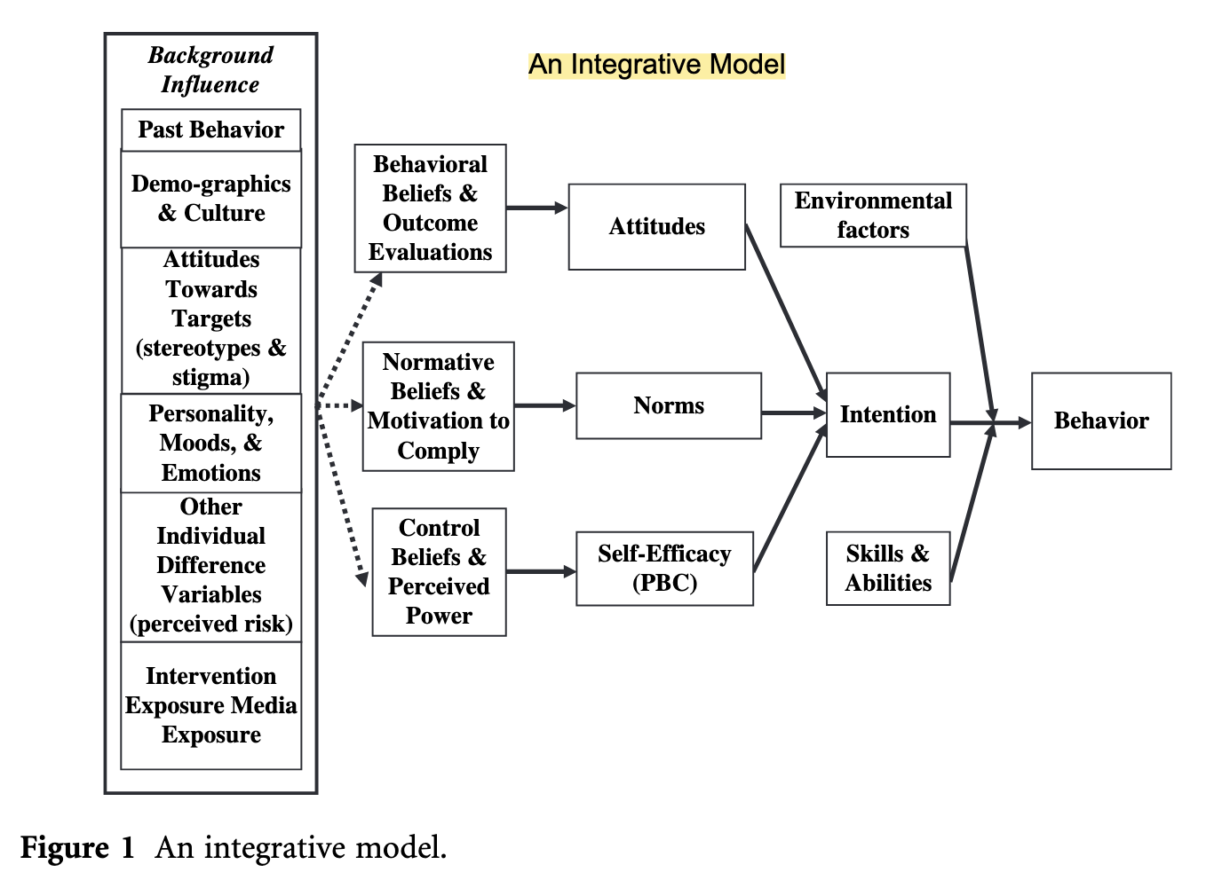
(Fishbein & Cappella, 2006)
Notes:
Behavior change model
Can you tell us what this is showing us? Kid-appropriate language. (write it down) What stood out to you from this model? Where do you see opportunities for youth input in this model? Where might our expertise and skill be needed?
Formative research to capture youth perspectives on youth behavior

Slide 7
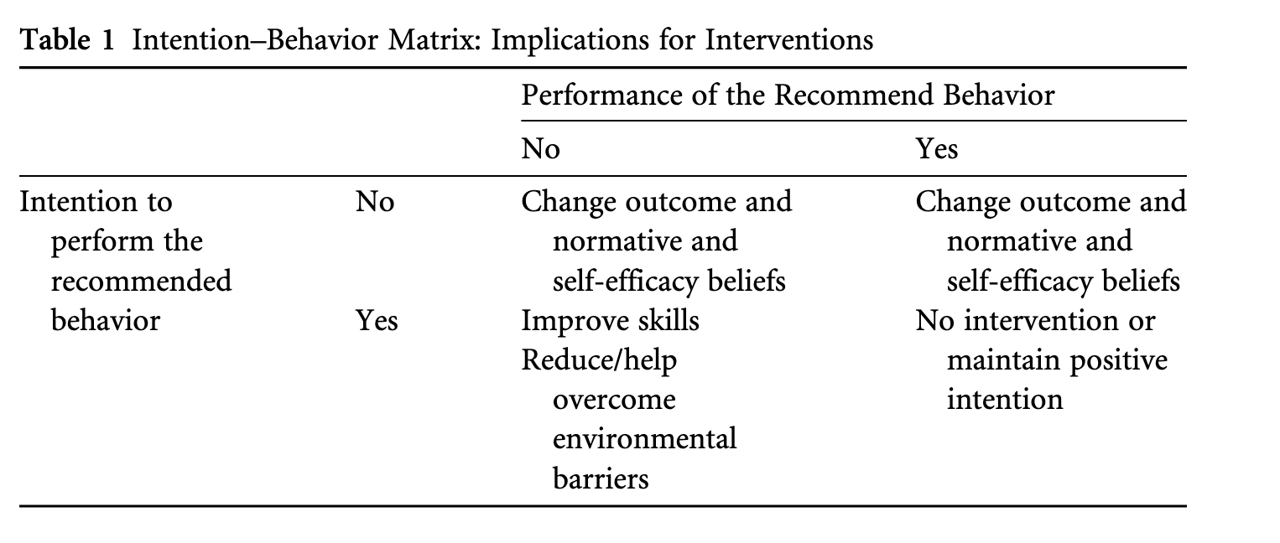
(Fishbein & Cappella, 2006)
Notes:
Can you tell us what this is showing us? Kid-appropriate language. (write it down) What stood out to you from this model? Where do you see opportunities for youth input in this model? Where might our expertise and skill be needed?
Formative research to capture youth perspectives on youth behavior

Slide 8
Practice
Questions to consider
Possible Interventions
Details
Behavior: Accessing green space more often to improve mental health
Intention: yes
Performance of the recommended behavior: no
Population?
Target?
Context?
Time?
Underlying or Discriminating beliefs?
Priming?
Persuasion?
What could this look like?
Positive thoughts
Little counterarguing
Notes:
Already captured data on underlying beliefs shaping a specific behavior and determined attention
Yes: improve skills -
Reduce environmental barriers -
the action (getting), the target (a mammogram), and the context (at the Women’s Clinic). Clearly, a change in any one of these elements changes the behavior under consideration.
Similarly, one can determine, for the population under consideration, whether the intention to get a colonoscopy is influenced primarily by attitudes, norms, or self-efficacy. Finally, one can identify the specific beliefs (be they behavioral, normative, or control beliefs) that discriminate between those who do and those who do not (intend to) perform the behavior.
Once it has been demonstrated that one can predict attitudes, norms, and self-efficacy from these salient beliefs, one can search for differences in these beliefs among those who do and do not intend to perform the behavior in question. Such an analysis not only provides information concerning the factors influencing a person’s decision to perform or not perform the behavior in question but also identifies those beliefs that would have to be changed to produce a change in attitudes, perceived norms, or self-efficacy.
tailored messaging, narrative-based communication, patient education materials, interactive workshops, community outreach programs, social media campaigns, video demonstrations, role-playing exercises, health literacy training, peer-to-peer counseling, and interventions focused on specific communication skills like active listening or motivational interviewing
1. Health Campaigns:
Digital Media Literacy Programs
3. Educational Interventions:
Organizational Communication
Public Opinion Shaping
Conflict Resolution and Mediation
Marketing and Advertising

Slide 9
Case 1
Behavior: Keep outdoor lunch space trash free
Intention: no
Performance of Recommended behavior: No
What beliefs (attitudinal, norms, or self-efficacy) do you think play the largest role in determining this behavior?
Describe theory-informed factors/questions to consider
Propose a possible communication intervention
Scenarios
Behavior: Participate in after school gardening program
Intention: yes
Performance of Recommended behavior: No
What beliefs (attitudinal, norms, or self-efficacy) do you think play the largest role in determining this behavior?
Describe theory-informed factors/questions to consider
Propose a possible communication intervention
Case 2
Notes:
Identify the population
Clearly, to understand why people do or do not hold a given intention (or perform a given behavior), it is important to first determine the degree to which that intention (or behavior) is under attitudinal, normative, or self-efficacy control in the population in question.
Technically a reverse but view it as a thought experiment

Slide 10

Reflection
What is the role of theory in YPACR?
How can we increase the engagement of our youth team members?
How can we integrate theory into our interactions with youth AND in our projects?

Slide 11
Theory integration
Behavior change
Information processing
Message effect
Determinants of risky and healthy behavior
Psychological processes and contextual characteristics associated with encoding, storage, retrieval, and retrieval
Predictions about the format and content of messages shape cognitive, attitudinal, and emotional outcomes
(Cappella, 2006)

